Slide 1
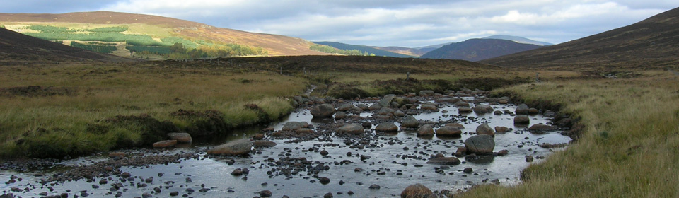
Model Calibration and Uncertainty
Markus Hrachowitz
m.hrachowitz@tudelft.nl
Room 4.87

Slide 2
After this lecture you will
Objectives
Sources of uncertainty
Why do we care?
Calibration
Objective functions
Optimization
Parameter uncertainty
New approaches
What have we learned?
be able to describe sources of uncertainty in hydrological models
be able to identify and classify model parameter calibration procedures
be able to explain and discuss different model performance measures
be able to analyze and assess different model evaluation techniques

Slide 3
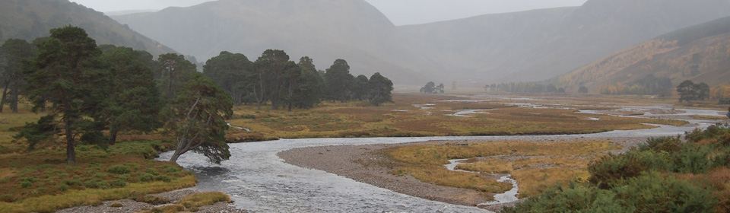
Hydrological models
✓ Objectives
Sources of uncertainty
Why do we care?
Calibration
Objective functions
Optimization
Parameter uncertainty
New approaches
What have we learned?
Q←m(X,ϑ, S₀)
Q: system response
m: hydrological model
X: inputs
ϑ: model parameters
S₀: initial and boundary conditions
Each component is subject to uncertainty

Slide 4
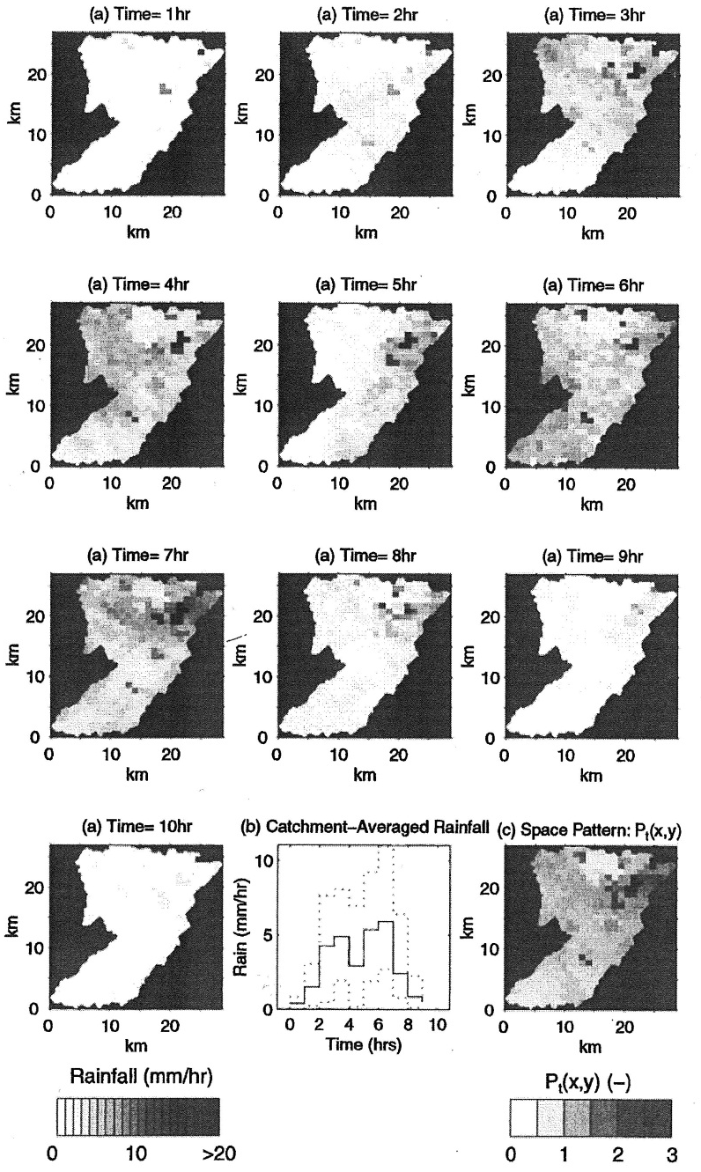
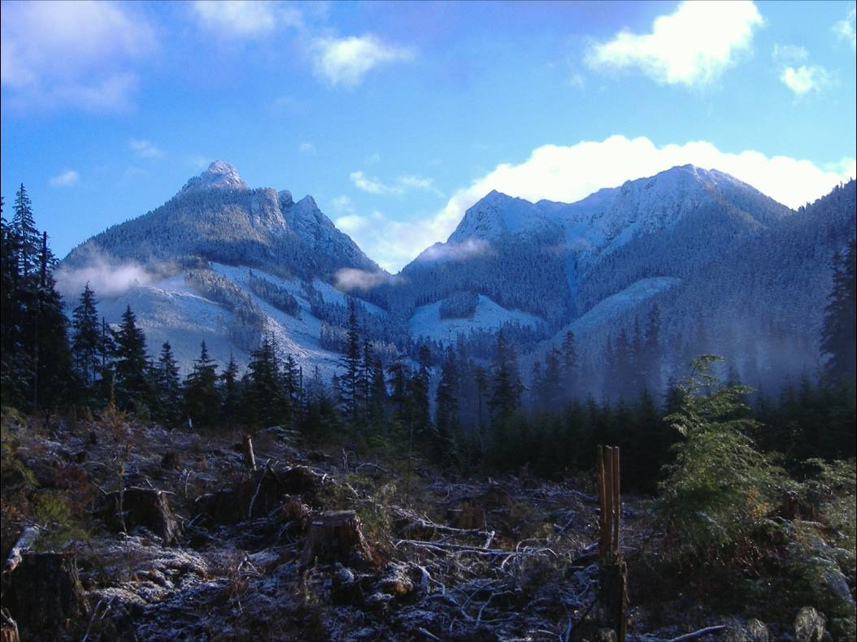
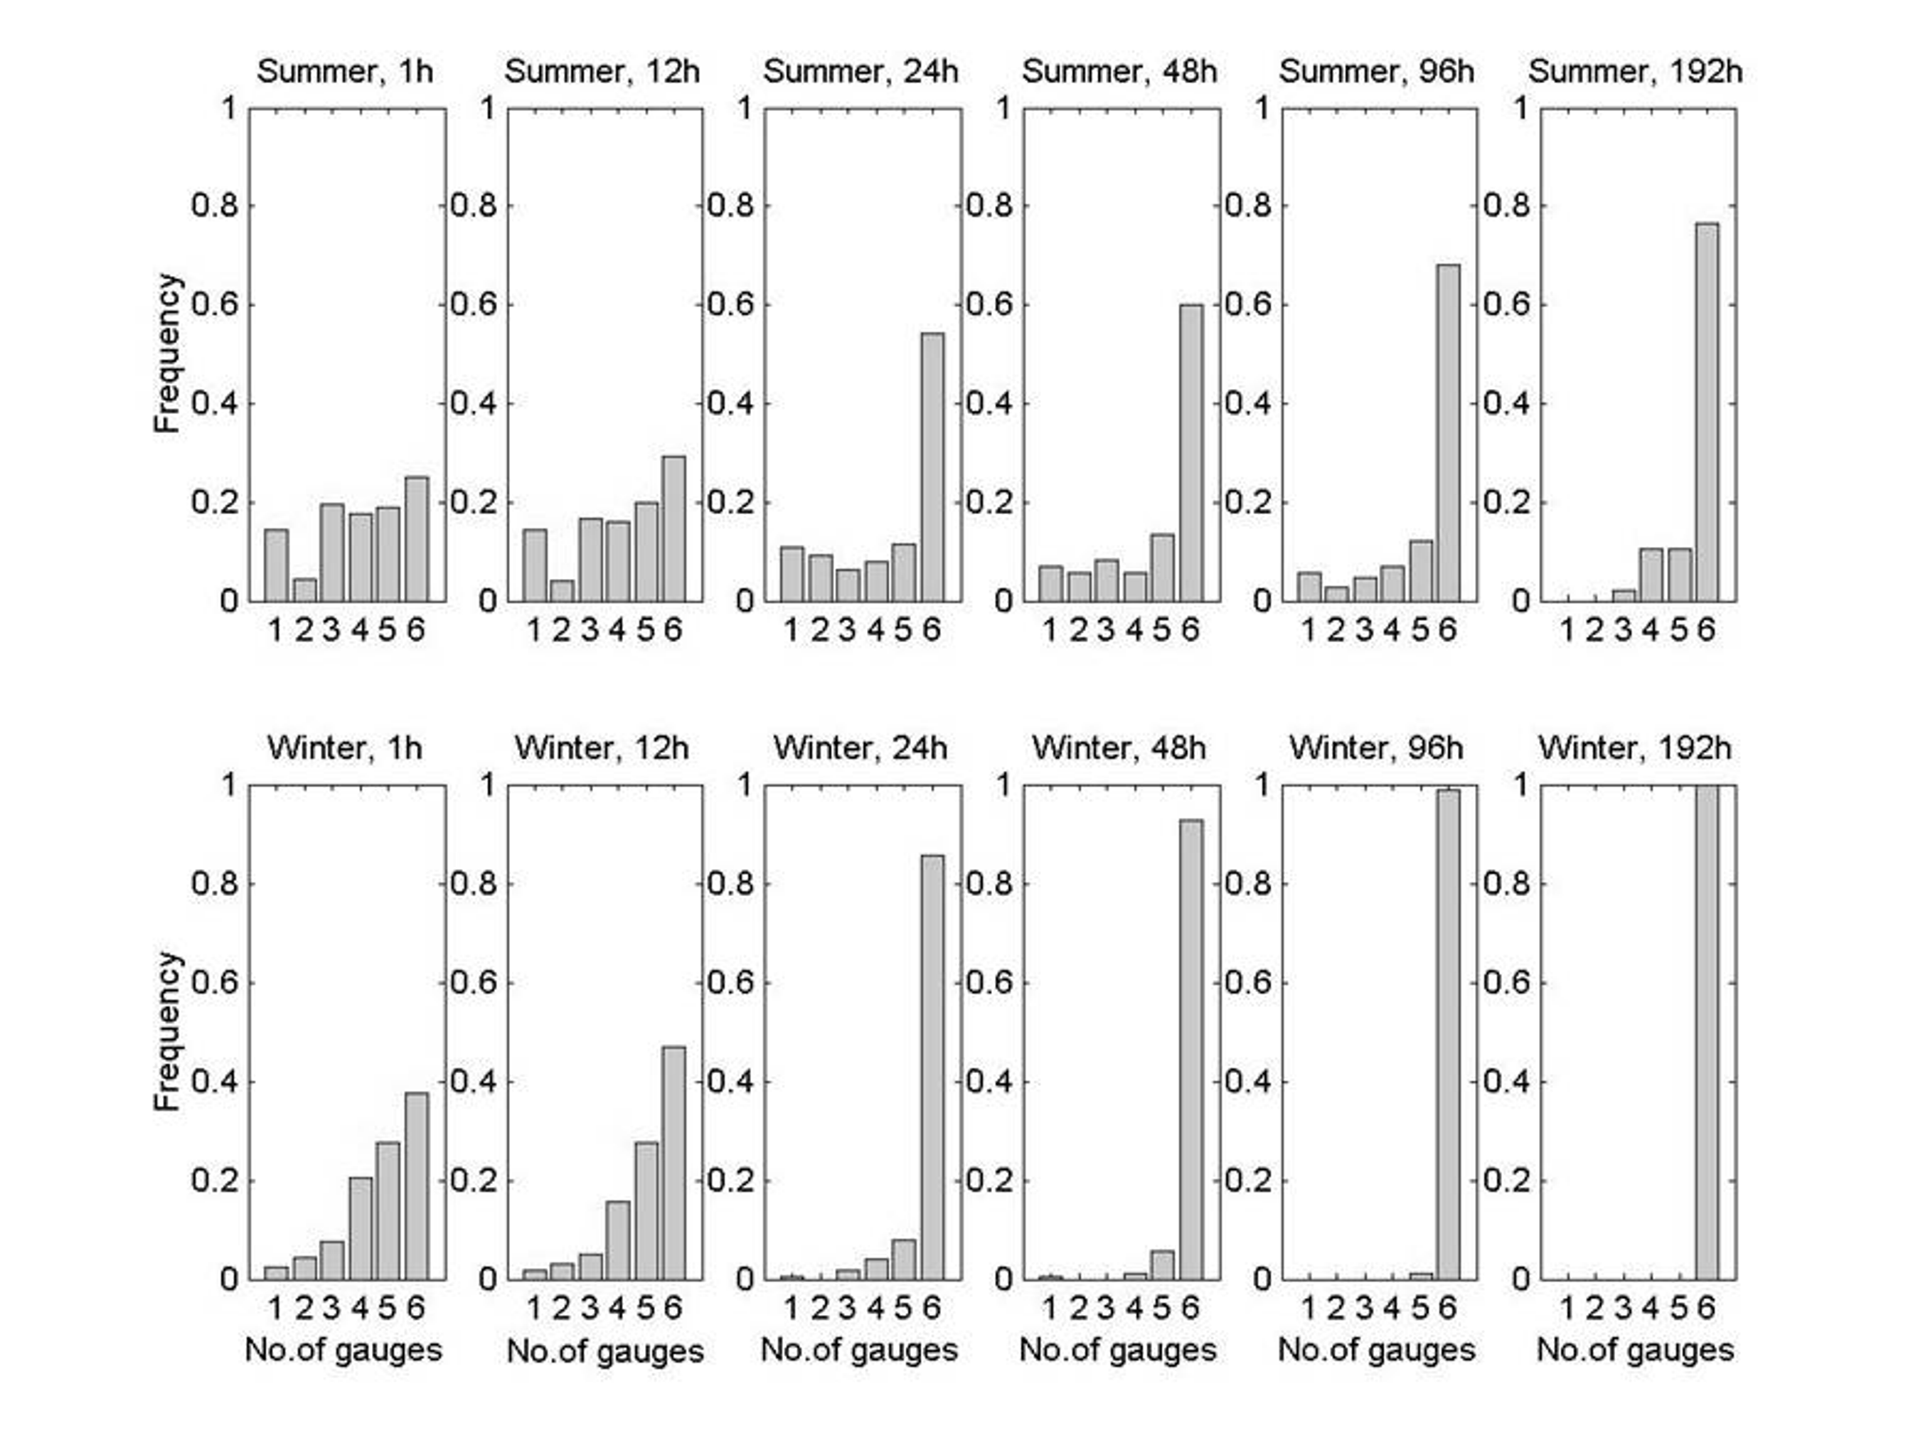


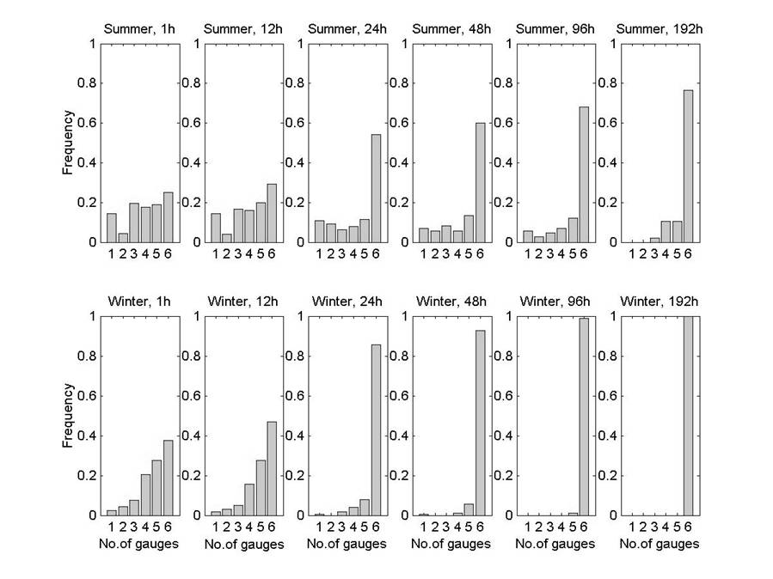
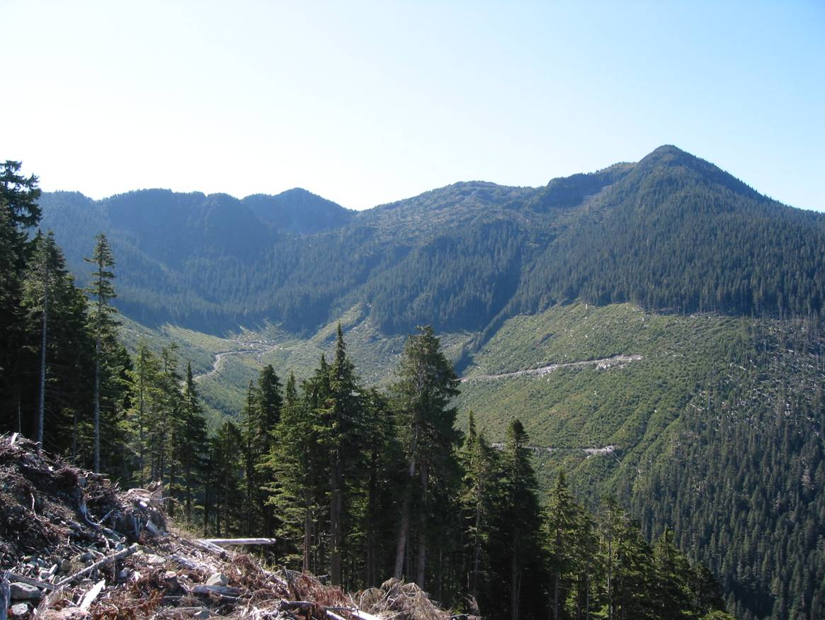
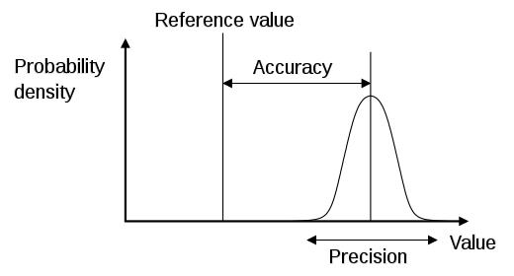
Sources of uncertainty
Low precision High accuracy
High precision Low accuracy
✓ Objectives
Sources of uncertainty
Why do we care?
Calibration
Objective functions
Optimization
Parameter uncertainty
New approaches
What have we learned?
Observational uncertainty
(i) instrument precision
(ii) measurement accuracy
(iii) spatial and temporal heterogeneity
(How representative is the measurement?)
Present in:
(i) input (e.g. rain, evaporation)
(ii) response (runoff, groundwater, chemical composition)
Model structure uncertainty
Imperfect conceptualization of system
Model parameter uncertainty
Different parameter combinations can yield same result
Example:
Catchment 5km²,
6 rain gauges
Proportion of rain gauges that record rain when one of them is recording rain

Slide 5
Error propagation in catchment modelling
✓ Objectives
✓ Sources of uncertainty
Why do we care?
Calibration
Objective functions
Optimization
Parameter uncertainty
New approaches
What have we learned?
True forcing inputs
Forcing data errors
Observed forcing data
CATCHMENT MODEL
True dynamics
Model structure error
Model parameters
error
Simulated response
True response
≠
!!!
Observed response
Response data errors

Slide 6
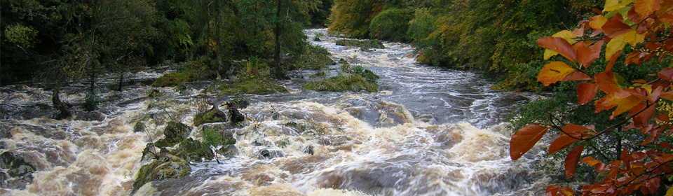
Parameter estimation
✓ Objectives
✓ Sources of uncertainty
✓ Why do we care?
Calibration
Objective functions
Optimization
Parameter uncertainty
New approaches
What have we learned?
Q← m(X,ϑ,S₀)
Direct measurement (problem of scale)
Derivation from analysis of measured variables (problem of scale, uniqueness of place)
Calibration

Slide 7
Calibration
✓ Objectives
✓ Sources of uncertainty
✓ Why do we care?
Calibration
Objective functions
Optimization
Parameter uncertainty
New approaches
What have we learned?
Calibration is a process of parameter adjustment (automatic or manual), until observed and calculated output time-series show a sufficiently high degree of similarity
Model parameters are conceptual representations of abstract watershed characteristics - not independently measurable

Slide 8
Manual calibration
✓ Objectives
✓ Sources of uncertainty
✓ Why do we care?
Calibration
Objective functions
Optimization
Parameter uncertainty
New approaches
What have we learned?
Also called “Trial-and-error”
Based on:
a) Visual inspection of the hydrograph
b) Different measures of performance
Can produce good results but:
a) time consuming
b) not objective

Slide 9
Automatic calibration
✓ Objectives
✓ Sources of uncertainty
✓ Why do we care?
Calibration
Objective functions
Optimization
Parameter uncertainty
New approaches
What have we learned?
Computer based
Fast
Objective
but
The resulting hydrographs are often perceived to be inferior to those produced through manual calibration from the hydrologist’s point of view

Slide 10
Automatic calibration
✓ Objectives
✓ Sources of uncertainty
✓ Why do we care?
Calibration
Objective functions
Optimization
Parameter uncertainty
New approaches
What have we learned?
Parameter calibration problem is set as an optimization problem
Optimization means finding the parameters that maximise or minimise a certain function
Model performance is expressed as a function of model parameters (objective function N)
Q_{m} = m(X,ϑ,S₀)
Q_{o} : observed system response
N_{obj}=f(Q_{m},Q_{o})

Slide 11
Objective functions
✓ Objectives
✓ Sources of uncertainty
✓ Why do we care?
✓ Calibration
Objective functions
Optimization
Parameter uncertainty
New approaches
What have we learned?
Objective functions aggregate model residuals in time
Different functions can express the error associated to different aspects of the simulation (e.g. high flow, low flow, bias, groundwater dynamics)

Slide 12
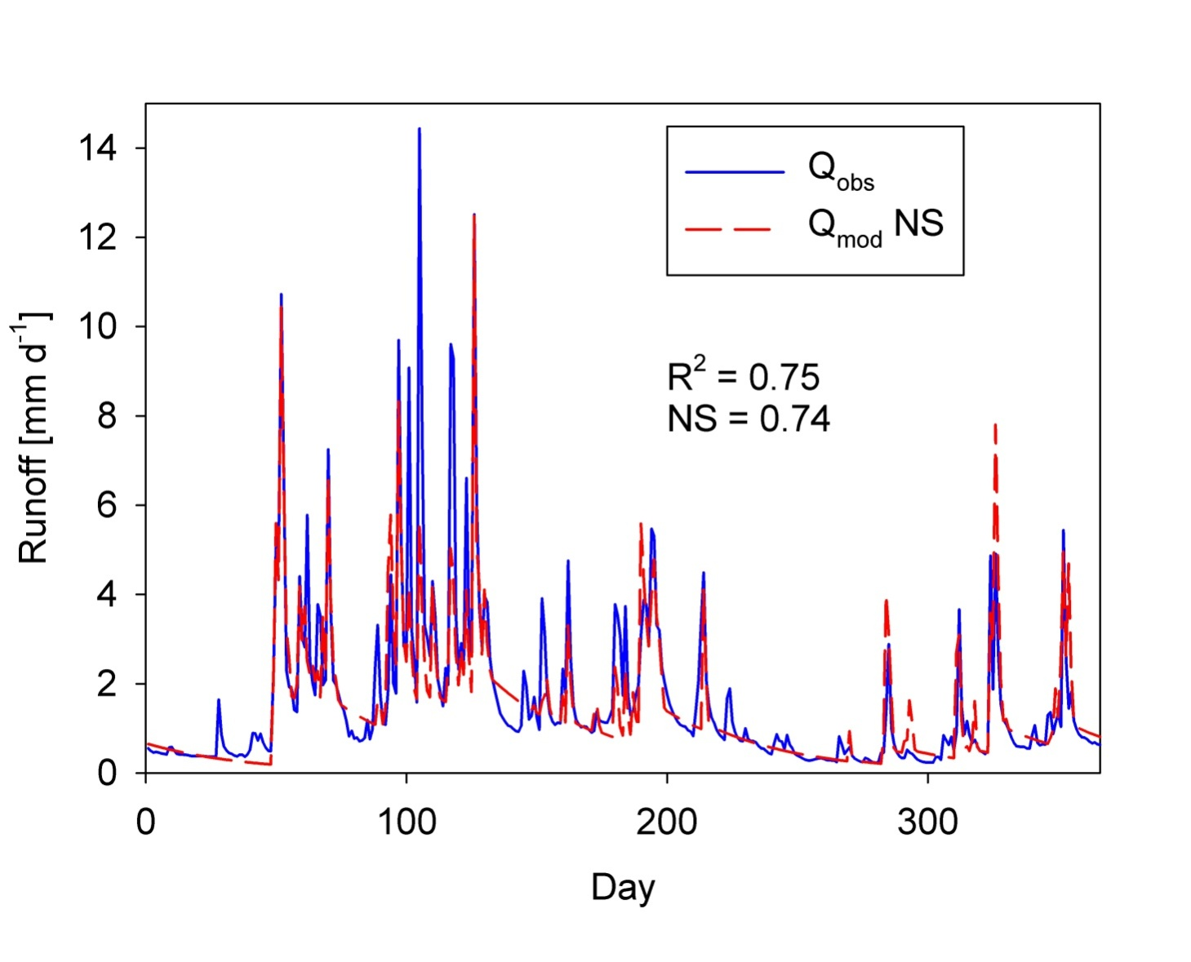
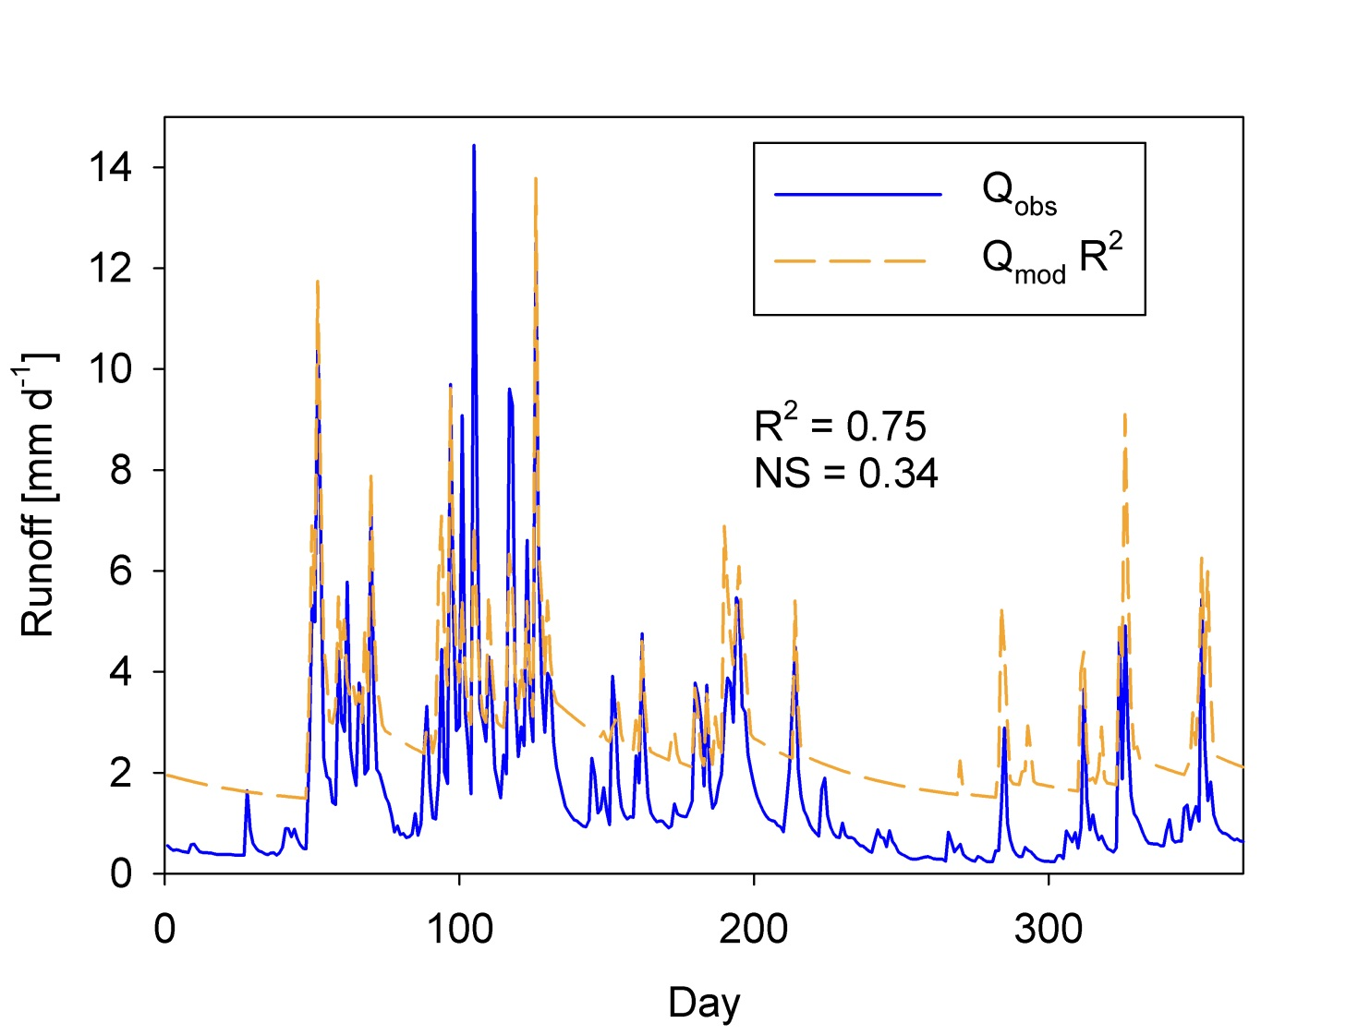
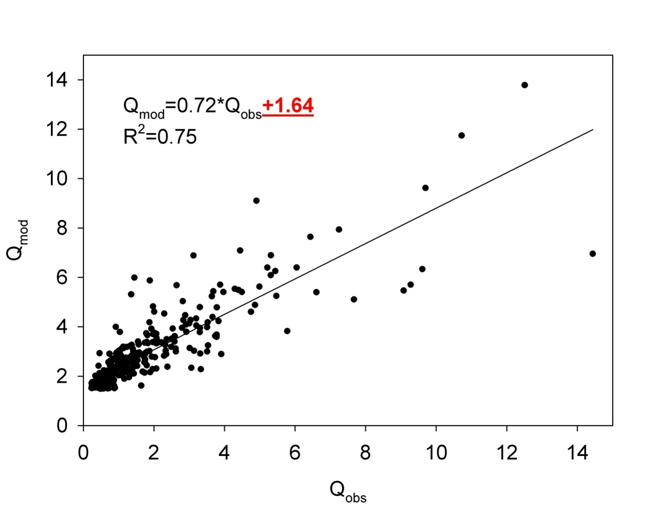
Objective functions
Coefficient of determination
(timing, 0 ≤ R² ≤ 1)
Nash-Sutcliffe efficiency
(high flow, 0 ≤ NS ≤ 1)
Log Nash-Sutcliffe efficiency
(low flow, 0 ≤ logNS ≤ 1)
Mean square error
(high flow, 0 ≤ MSE ≤ ∞)
Bias (0 ≤ Bias ≤ ∞)
✓ Objectives
✓ Sources of uncertainty
✓ Why do we care?
✓ Calibration
Objective functions
Optimization
Parameter uncertainty
New approaches
What have we learned?
Bias !
Bias !

Slide 13
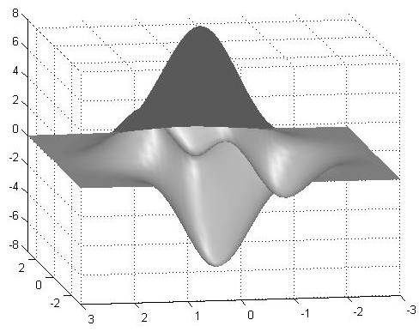
Optimization of objective functions
How does the response surface of objective function N_{obj}=f(ϑ) look like?
Complex landscapes with multiple curving ridges
Small- and large-scale discontinuities
Multiple optima
✓ Objectives
✓ Sources of uncertainty
✓ Why do we care?
✓ Calibration
Objective functions
Optimization
Parameter uncertainty
New approaches
What have we learned?
N_{obj}
ϑ₂
ϑ₁

Slide 14
Optimization of objective functions
Search strategies for finding optimal parameter set
Local search strategies can converge in a local minimum instead of the global one
Solved with global search strategies that use randomized search
✓ Objectives
✓ Sources of uncertainty
✓ Why do we care?
✓ Calibration
✓ Objective functions
Optimization
Parameter uncertainty
New approaches
What have we learned?
N_{obj}
Local minima
Global minimum
ϑ₂
ϑ₁

Slide 15
Optimization of objective functions
✓ Objectives
✓ Sources of uncertainty
✓ Why do we care?
✓ Calibration
✓ Objective functions
Optimization
Parameter uncertainty
New approaches
What have we learned?
Global search strategies for finding optimal parameter set:
Stochastic
(a) Monte-Carlo sampling,
(b) Simulated annealing,…
Heuristic
(a) Genetic algorithms,
(b) Shuffled Complex Evolution,
(c) Ant-Colony and Particle Swarm methods,…

Slide 16
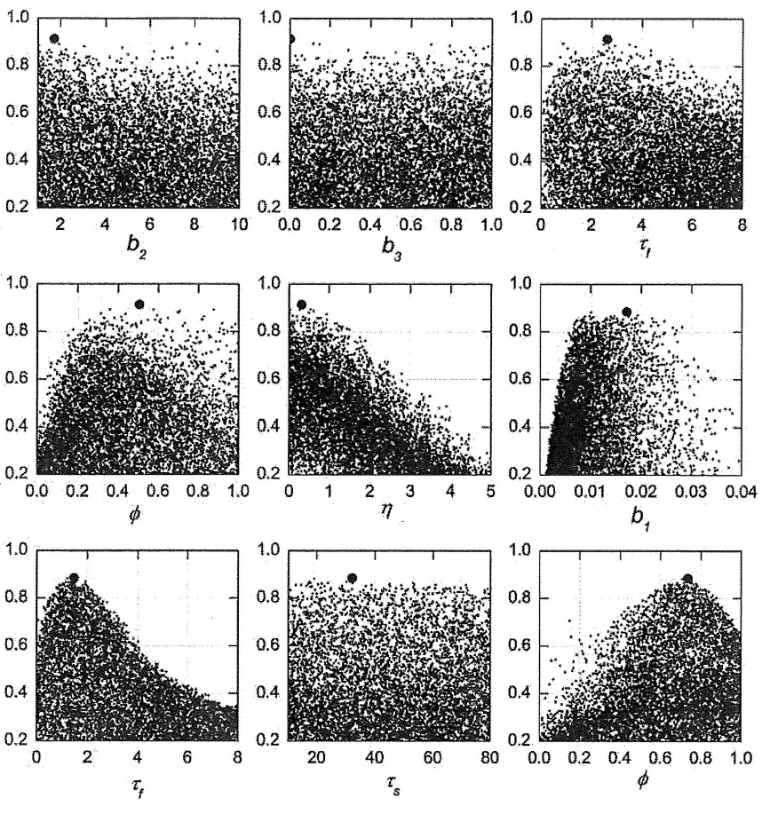
Optimization of objective functions
✓ Objectives
✓ Sources of uncertainty
✓ Why do we care?
✓ Calibration
✓ Objective functions
Optimization
Parameter uncertainty
New approaches
What have we learned?
Monte Carlo Sampling
Randomly sample each parameter from prior distribution
Very simple
Time consuming
Although good information about the region of optimal parameters, best parameters unlikely to be found
Nash-Sutcliffe Efficiency

Slide 17
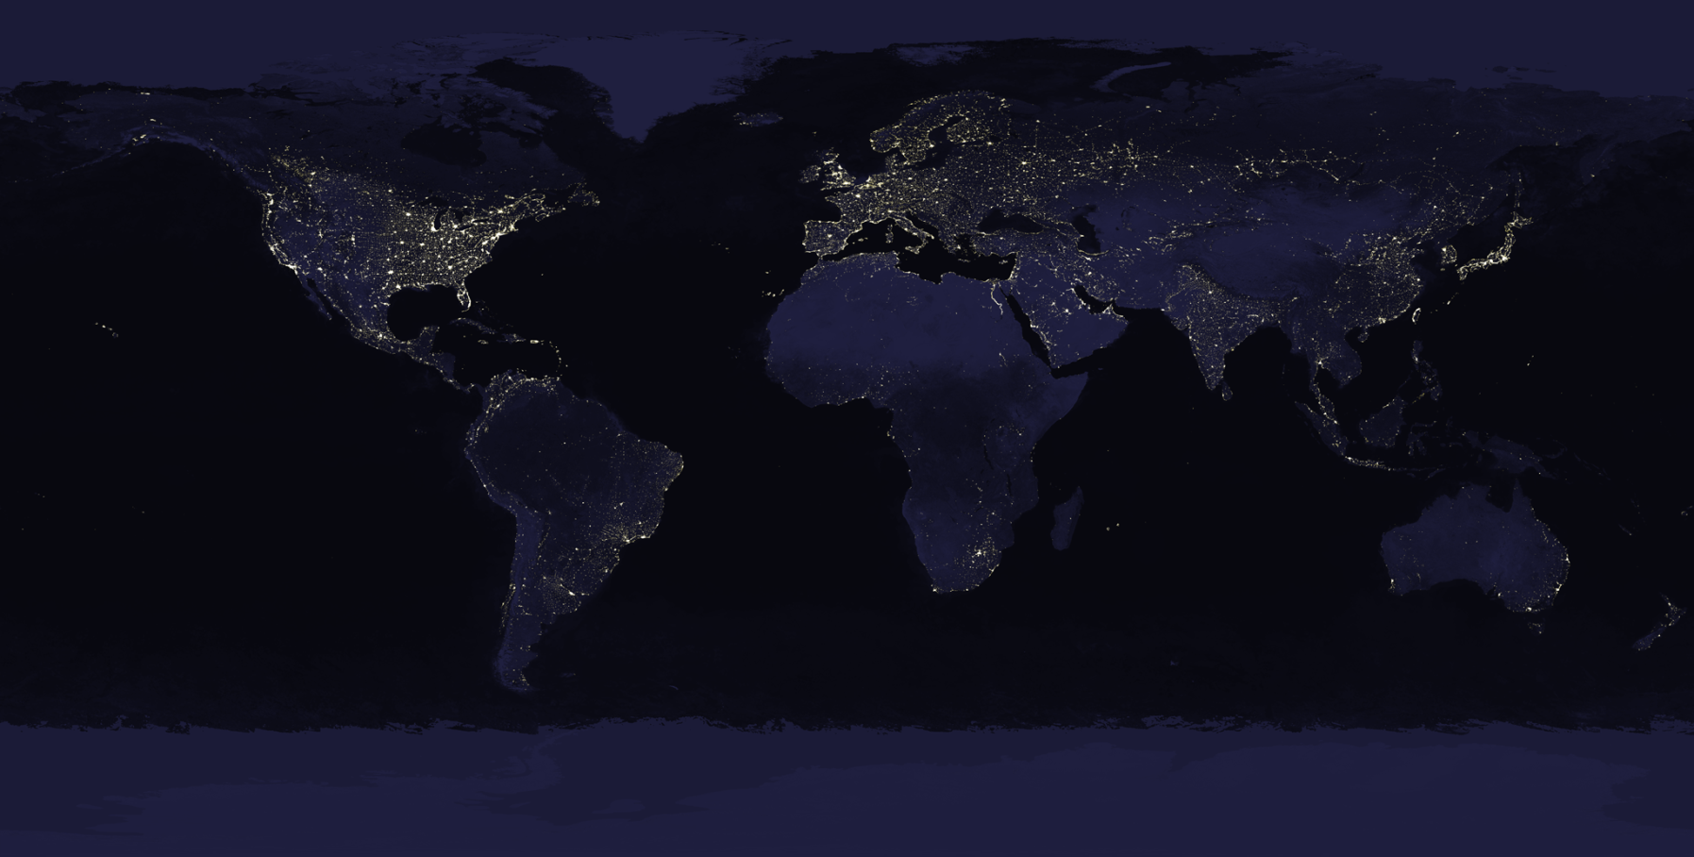
Optimization of objective functions
✓ Objectives
✓ Sources of uncertainty
✓ Why do we care?
✓ Calibration
✓ Objective functions
Optimization
Parameter uncertainty
New approaches
What have we learned?
Evolutionary algorithms

Slide 18
Optimization of objective functions
✓ Objectives
✓ Sources of uncertainty
✓ Why do we care?
✓ Calibration
✓ Objective functions
Optimization
Parameter uncertainty
New approaches
What have we learned?
Evolutionary algorithms

Slide 19

Optimization of objective functions
✓ Objectives
✓ Sources of uncertainty
✓ Why do we care?
✓ Calibration
✓ Objective functions
Optimization
Parameter uncertainty
New approaches
What have we learned?
Evolutionary algorithms

Slide 20
Optimization of objective functions
✓ Objectives
✓ Sources of uncertainty
✓ Why do we care?
✓ Calibration
✓ Objective functions
Optimization
Parameter uncertainty
New approaches
What have we learned?
Evolutionary algorithms

Slide 21

Optimization of objective functions
✓ Objectives
✓ Sources of uncertainty
✓ Why do we care?
✓ Calibration
✓ Objective functions
Optimization
Parameter uncertainty
New approaches
What have we learned?
Evolutionary algorithms

Slide 22

Optimization of objective functions
✓ Objectives
✓ Sources of uncertainty
✓ Why do we care?
✓ Calibration
✓ Objective functions
Optimization
Parameter uncertainty
New approaches
What have we learned?
Evolutionary algorithms

Slide 23

Optimization of objective functions
✓ Objectives
✓ Sources of uncertainty
✓ Why do we care?
✓ Calibration
✓ Objective functions
Optimization
Parameter uncertainty
New approaches
What have we learned?
Evolutionary algorithms

Slide 24
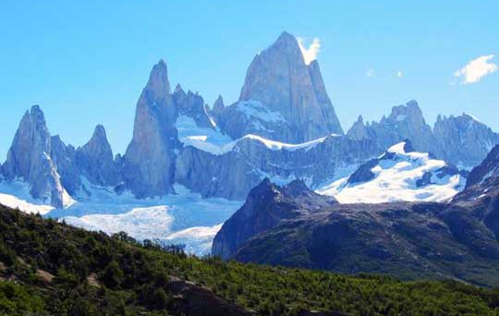
Optimization of objective functions
✓ Objectives
✓ Sources of uncertainty
✓ Why do we care?
✓ Calibration
✓ Objective functions
Optimization
Parameter uncertainty
New approaches
What have we learned?
Evolutionary algorithms

Slide 25
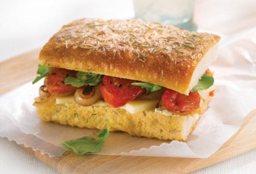
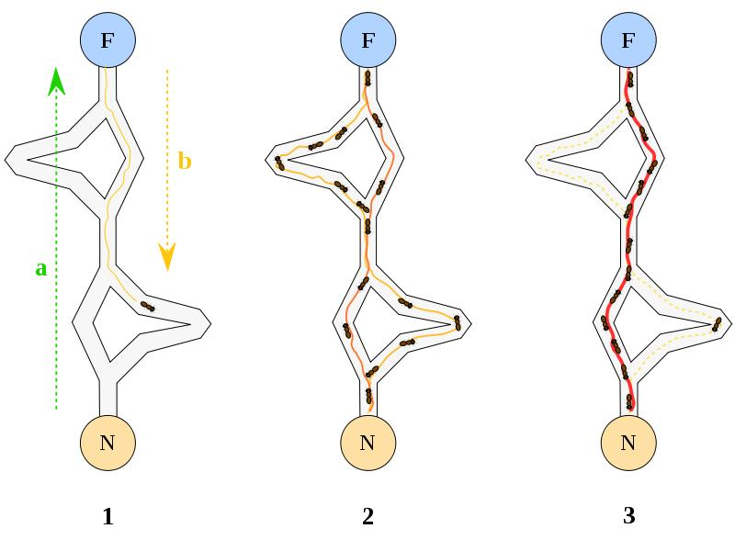
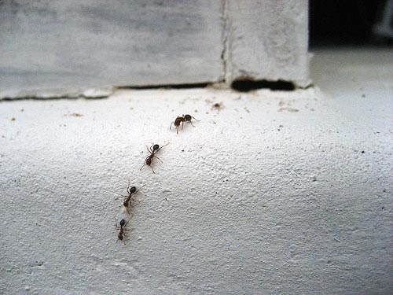
Optimization of objective functions
Ant-Colony optimization
Mimics self-organizing dynamics of nature
Based on collective “intelligence” of insects
Collective of ants finds shortest route to food
Leave pheromone trail, attracting other ants
The more ants, the more pheromone, the more ants → positive feedback process (self-organization)
✓ Objectives
✓ Sources of uncertainty
✓ Why do we care?
✓ Calibration
✓ Objective functions
Optimization
Parameter uncertainty
New approaches
What have we learned?

Slide 26
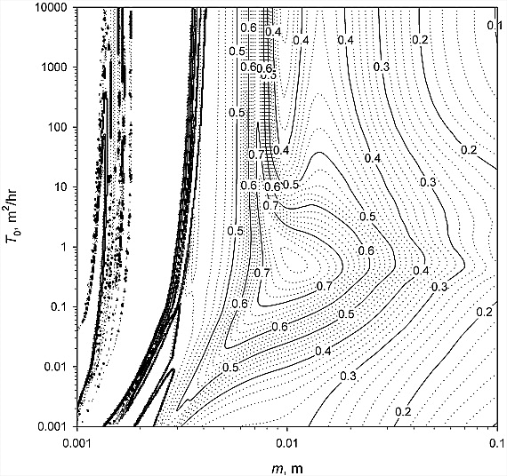
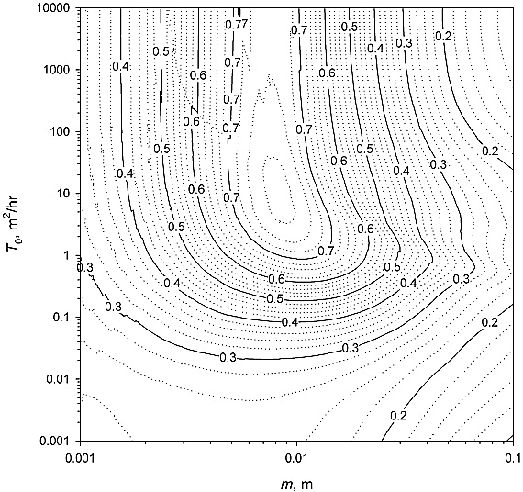
Optimization of objective functions
Complex shape of objective functions can be a numerical artifact
Remember exercise 1
Using a too large time step introduces large numerical error
This can affect the shape of the objective function
✓ Objectives
✓ Sources of uncertainty
✓ Why do we care?
✓ Calibration
✓ Objective functions
Optimization
Parameter uncertainty
New approaches
What have we learned?
1. Fixed-step explicit Euler
2. Adaptive substepping

Slide 27
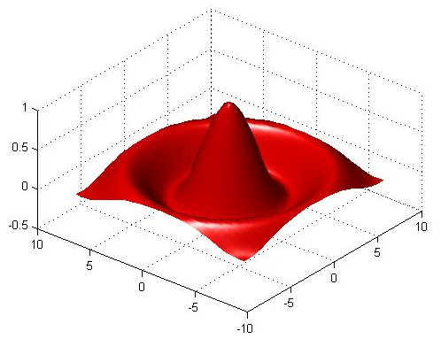
Optimization of objective functions
✓ Objectives
✓ Sources of uncertainty
✓ Why do we care?
✓ Calibration
✓ Objective functions
Optimization
Parameter uncertainty
New approaches
What have we learned?
Multiple optima
Response surface can have more than one optimum
Many parameter sets may yield equally good results
This has impact on parameter and predictive uncertainty

Slide 28
Parameter uncertainty
Multiple optima – different approaches
Accept existence of multiple optima and introduce concept of equifinality (GLUE)
Use of Bayesian statistics to address in a formal way problems related to data uncertainty
Accept that a single objective function is not appropriate: instead use more criteria and objectives to constrain the problem (Multi-criteria, multi- objective calibration)
✓ Objectives
✓ Sources of uncertainty
✓ Why do we care?
✓ Calibration
✓ Objective functions
✓ Optimization
Parameter uncertainty
New approaches
What have we learned?

Slide 29
Parameter uncertainty
✓ Objectives
✓ Sources of uncertainty
✓ Why do we care?
✓ Calibration
✓ Objective functions
✓ Optimization
Parameter uncertainty
New approaches
What have we learned?
GLUE
(Generalized Likelihood Uncertainty Estimation)
“The concept of a single description of reality may remain a philosophical axiom or theoretical aim but is impossible to achieve in practice”
“So we must accept that there may be many feasible descriptions, or a concept of equifinality, as the basis for a new approach”
(Keith Beven)

Slide 30
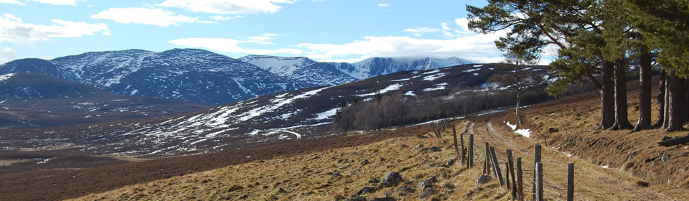
Parameter uncertainty
✓ Objectives
✓ Sources of uncertainty
✓ Why do we care?
✓ Calibration
✓ Objective functions
✓ Optimization
Parameter uncertainty
New approaches
What have we learned?
GLUE
(Generalized Likelihood Uncertainty Estimation)
Rejects the concept of an optimum model and parameter set
The existence of multiple likely models and parameter sets has been called equifinality

Slide 31
Parameter uncertainty
✓ Objectives
✓ Sources of uncertainty
✓ Why do we care?
✓ Calibration
✓ Objective functions
✓ Optimization
Parameter uncertainty
New approaches
What have we learned?
GLUE
(Generalized Likelihood Uncertainty Estimation)
(1) Prior to input of data into a model, all model structures and parameter sets have an equal likelihood of being acceptable
(2) A high number of parameter sets is generated via uniform Monte Carlo sampling
(3) The performance of each trial is assessed through a likelihood measure (e.g. Nash-Sutcliffe Efficiency)

Slide 32
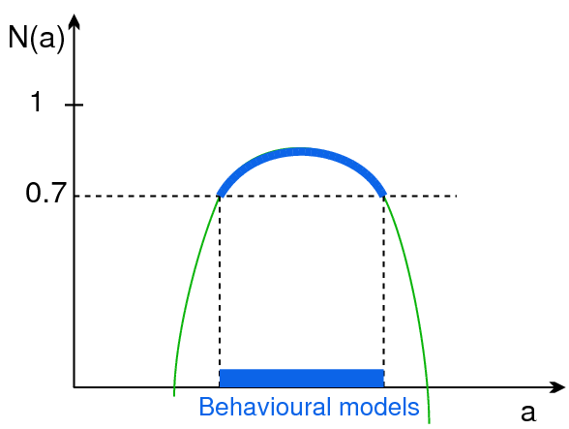
Parameter uncertainty
GLUE
(4) Only models, i.e. parameter sets and model structures, whose likelihood measure is above a threshold are retained (“behavioural models”), all others are discarded (“non-behavioural models”)
✓ Objectives
✓ Sources of uncertainty
✓ Why do we care?
✓ Calibration
✓ Objective functions
✓ Optimization
Parameter uncertainty
New approaches
What have we learned?

Slide 33
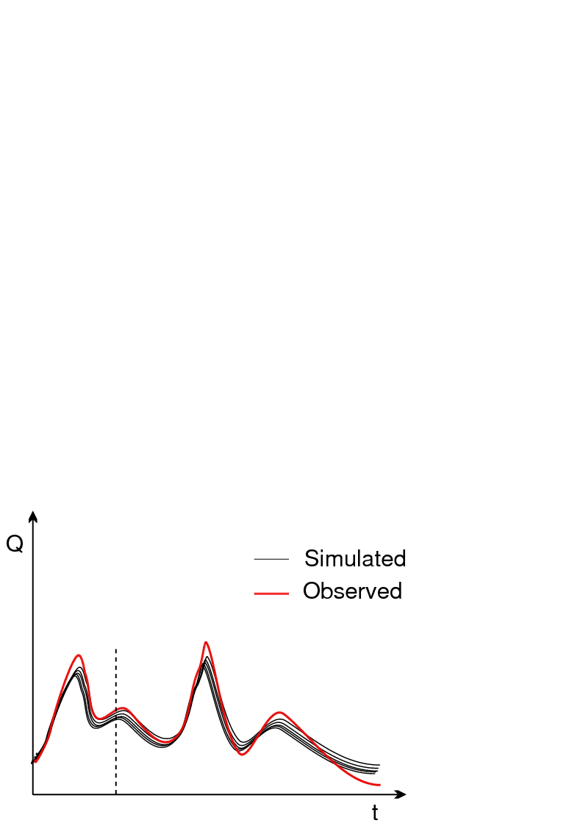
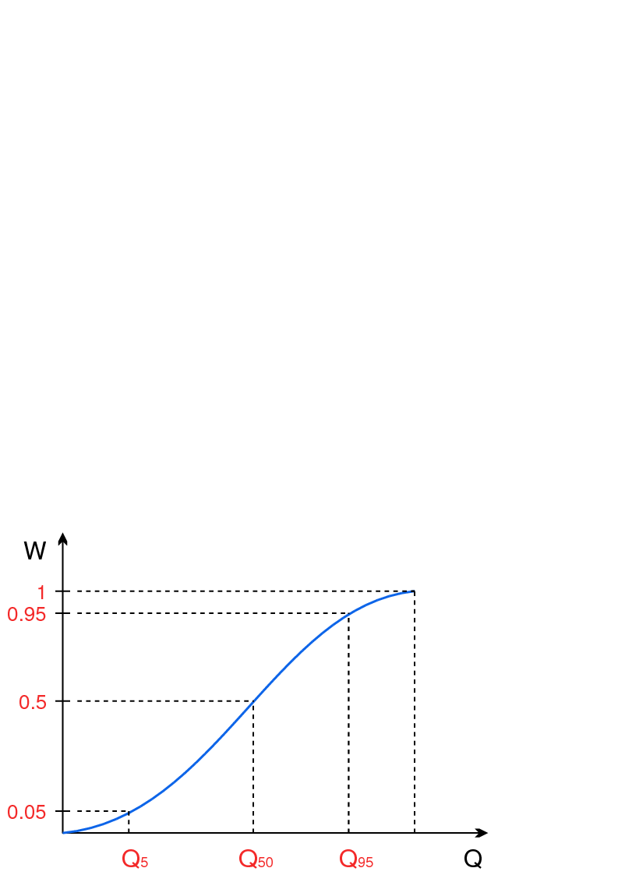
Parameter uncertainty
GLUE
(5) The calculated likelihoods are rescaled to a cumulative sum of 1
(6) For each time step, a cumulative distribution of simulated discharges is constructed using the rescaled weights
(7) Uncertainty bounds and median from cumulative distribution
✓ Objectives
✓ Sources of uncertainty
✓ Why do we care?
✓ Calibration
✓ Objective functions
✓ Optimization
Parameter uncertainty
New approaches
What have we learned?

Slide 34
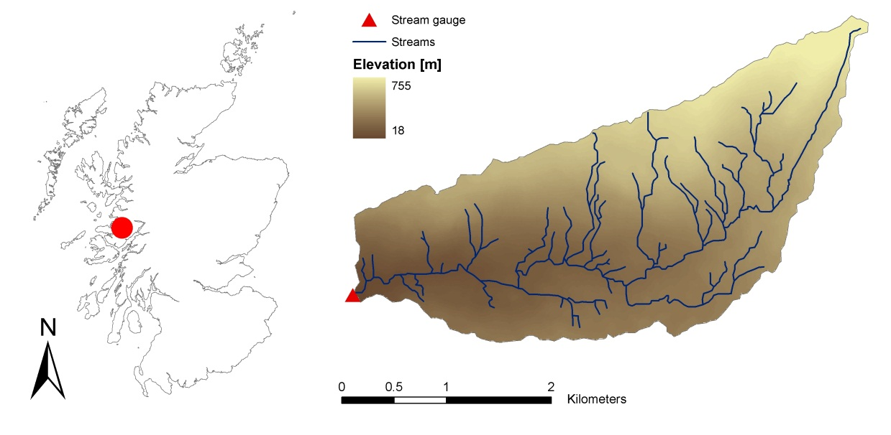
Parameter uncertainty
GLUE – example
10 km² catchment in Scotland
Modelling tracer dynamics in stream
2 parameter model (α,β)
✓ Objectives
✓ Sources of uncertainty
✓ Why do we care?
✓ Calibration
✓ Objective functions
✓ Optimization
Parameter uncertainty
New approaches
What have we learned?

Slide 35
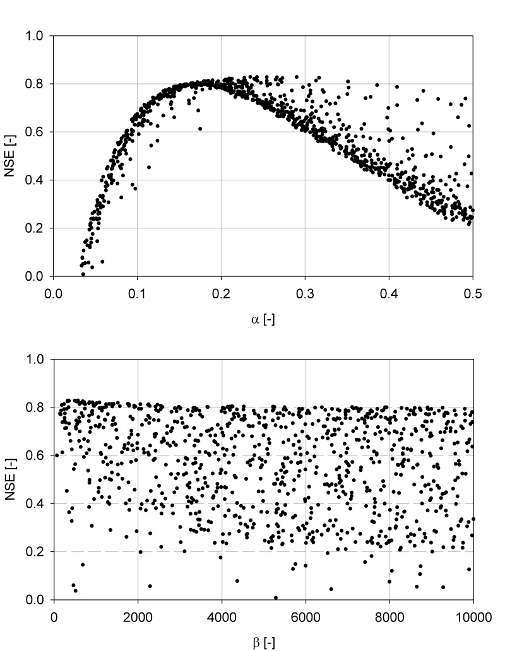
Parameter uncertainty
✓ Objectives
✓ Sources of uncertainty
✓ Why do we care?
✓ Calibration
✓ Objective functions
✓ Optimization
Parameter uncertainty
New approaches
What have we learned?
GLUE – example
Likelihood measure: Nash-Sutcliffe efficiency (NSE)
Threshold of acceptance: N_{NS} > 0.6
“behavioral models” - retained
“non-behavioral models” - discarded
“behavioral models” - retained
“non-behavioral models” - discarded

Slide 36
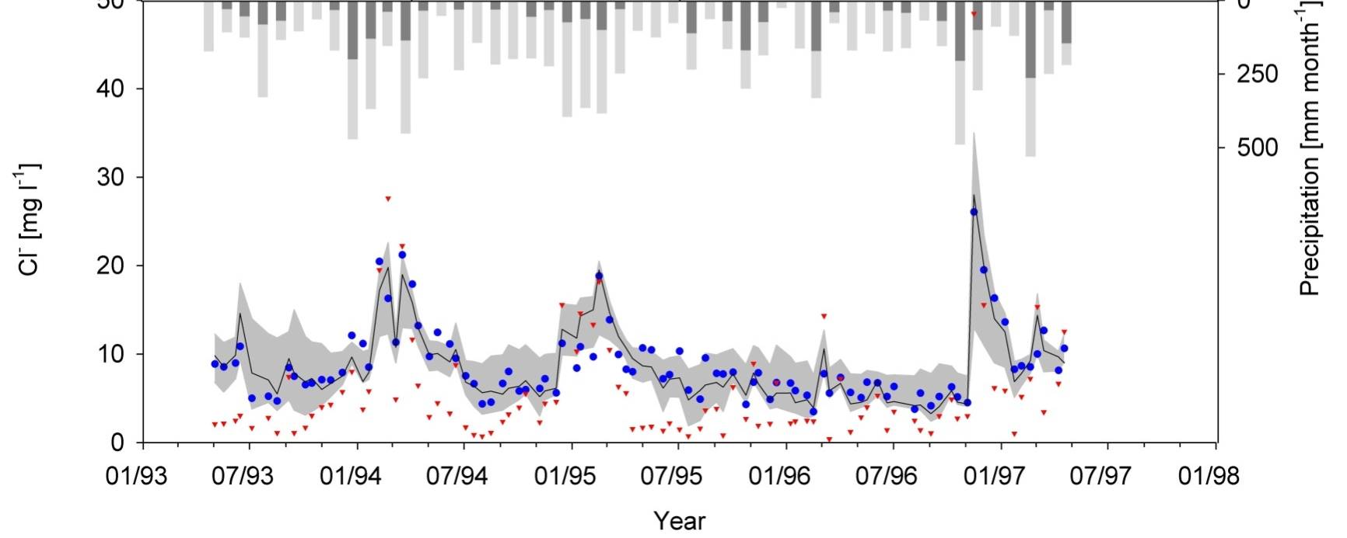
Parameter uncertainty
✓ Objectives
✓ Sources of uncertainty
✓ Why do we care?
✓ Calibration
✓ Objective functions
✓ Optimization
Parameter uncertainty
New approaches
What have we learned?
GLUE – example

Slide 37
Parameter uncertainty
GLUE
Glue introduces the problem of equifinality in hydrological modelling
Easy to understand and implement
Allows model evaluation with respect to performance and uncertainty
Limitation: subjectivity (choice of threshold!)
To limit subjectivity:
(a) “Limits of acceptability” approach
(b) Adjust threshold so that x% of observations fall within uncertainty interval
(c) Accept all models, but give higher weight to better models, e.g. NSE^{p}
✓ Objectives
✓ Sources of uncertainty
✓ Why do we care?
✓ Calibration
✓ Objective functions
✓ Optimization
Parameter uncertainty
New approaches
What have we learned?

Slide 38
Parameter uncertainty
Formal Bayesian approach
Likelihood functions should be based on hypotheses of the error
Example:
Q_{o,i} = Q_{m,i}+ ε_{i}
ε_{i} ~ N(μ=0; σ²)
✓ Objectives
✓ Sources of uncertainty
✓ Why do we care?
✓ Calibration
✓ Objective functions
✓ Optimization
Parameter uncertainty
New approaches
What have we learned?
Q_{o}
ε_{i}
Q_{m}

Slide 39
Parameter uncertainty
Formal Bayesian approach
Q_{o,i} = Q_{m,i}+ ε_{i}
ε_{i} ~ N(μ=0; σ²)
✓ Objectives
✓ Sources of uncertainty
✓ Why do we care?
✓ Calibration
✓ Objective functions
✓ Optimization
Parameter uncertainty
New approaches
What have we learned?
Q_{o}
ε_{i}
Q_{m}

Slide 40
Parameter uncertainty
Formal Bayesian approach
For Bayesian statistics estimating θ using least squares means adopting several assumptions:
(a) model is correct
(b) error is normally distributed, uncorrelated, with constant variance (homoscedastic) and zero mean
✓ Objectives
✓ Sources of uncertainty
✓ Why do we care?
✓ Calibration
✓ Objective functions
✓ Optimization
Parameter uncertainty
New approaches
What have we learned?
Q_{o}
ε_{i}
Q_{m}

Slide 41
Parameter uncertainty
Multi-objective calibration
Data contain different signatures of catchment behaviour
Information contained in the data represented by a single number
Information represented by this number is then transferred to the model parameters
Ideally parameter dimension should be the same as objective function dimension
✓ Objectives
✓ Sources of uncertainty
✓ Why do we care?
✓ Calibration
✓ Objective functions
✓ Optimization
Parameter uncertainty
New approaches
What have we learned?
Dimension
Data
Parameters
Objective
function

Slide 42
Parameter uncertainty
✓ Objectives
✓ Sources of uncertainty
✓ Why do we care?
✓ Calibration
✓ Objective functions
✓ Optimization
Parameter uncertainty
New approaches
What have we learned?
Multi-objective calibration
Acceptable parameter range can be constrained by defining multiple optimization targets:
(a) Multiple objective functions (objectives), e.g. NS, NS_{log}, R², to evaluate one single modelled time-series, e.g. streamflow
(b) Objective functions to evaluate multiple modelled variables (criteria), e.g. stream flow, groundwater, chemical composition
(c) Objective functions in the frequency domain, e.g. fit flow duration curves or frequency spectrum
(c) Combinations of (a), (b) and (c)

Slide 43
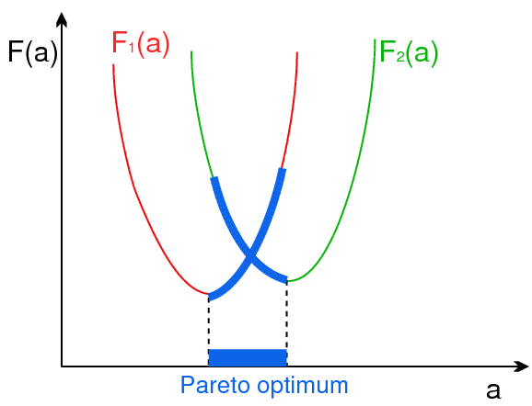
Parameter uncertainty
✓ Objectives
✓ Sources of uncertainty
✓ Why do we care?
✓ Calibration
✓ Objective functions
✓ Optimization
Parameter uncertainty
New approaches
What have we learned?
Multi-objective calibration
Pareto Optimality
Not possible to find two points within the Pareto set such that one has a better performance than the other with respect to all objective functions
For all non-members there exists at least one member that has a better performance with respect to all objective functions
Objective function F (a)
Parameter

Slide 44
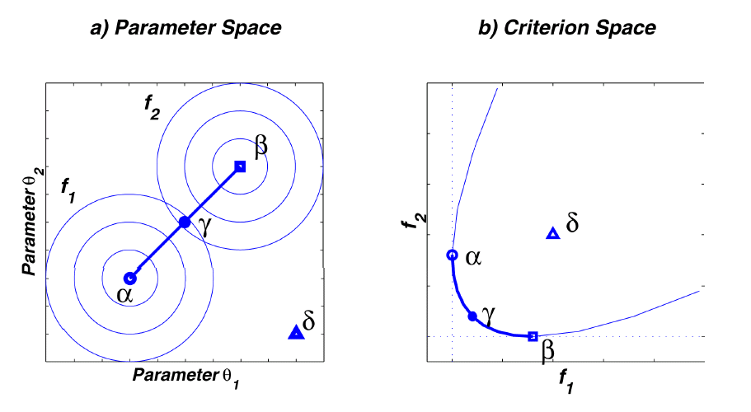
Parameter uncertainty
✓ Objectives
✓ Sources of uncertainty
✓ Why do we care?
✓ Calibration
✓ Objective functions
✓ Optimization
Parameter uncertainty
New approaches
What have we learned?
Multi-objective calibration: Pareto Optimality
(e.g. 1-NS_{log})
Pareto Solutions
(e.g. 1-NS)

Slide 45
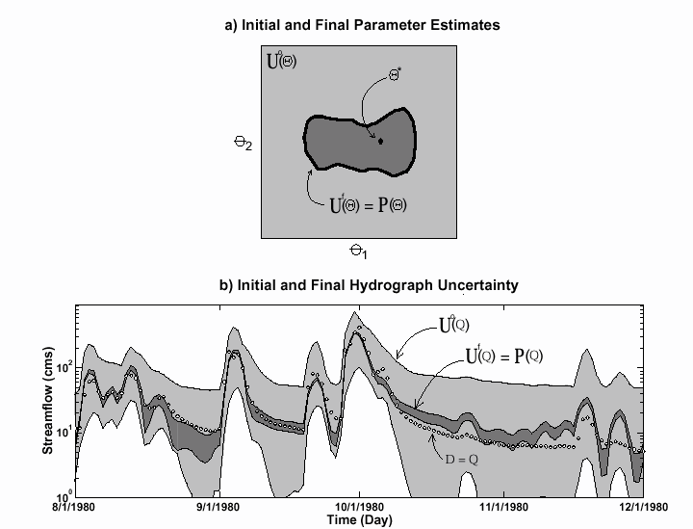
Parameter uncertainty
Multi-objective calibration
✓ Objectives
✓ Sources of uncertainty
✓ Why do we care?
✓ Calibration
✓ Objective functions
✓ Optimization
Parameter uncertainty
New approaches
What have we learned?

Slide 46
Parameter uncertainty
Multi-objective calibration: Example
HBV model
3 objective functions
✓ Objectives
✓ Sources of uncertainty
✓ Why do we care?
✓ Calibration
✓ Objective functions
✓ Optimization
Parameter uncertainty
New approaches
What have we learned?

Slide 47
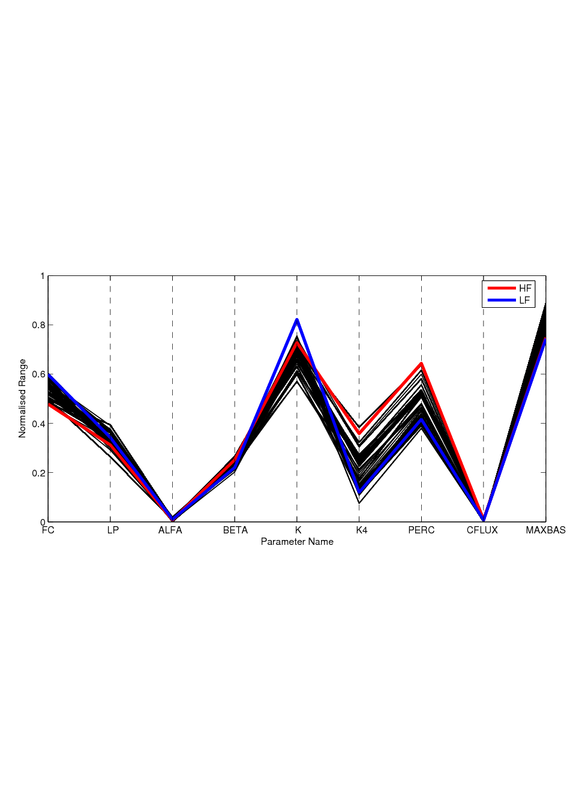
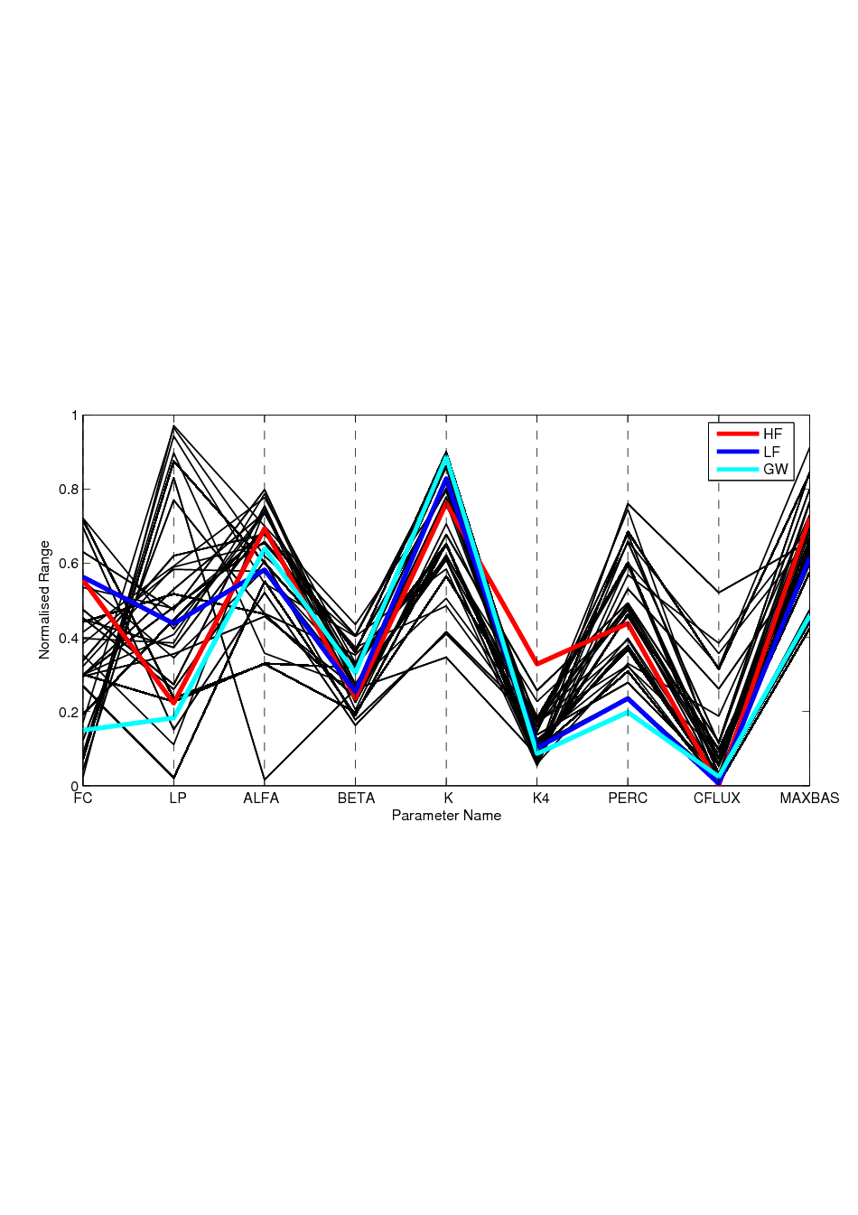
Parameter uncertainty
Multi-objective calibration: Example
✓ Objectives
✓ Sources of uncertainty
✓ Why do we care?
✓ Calibration
✓ Objective functions
✓ Optimization
Parameter uncertainty
New approaches
What have we learned?
Parameter ranges
N_{HF} and N_{LF}
N_{HF,} N_{LF} and N_{WT}

Slide 48
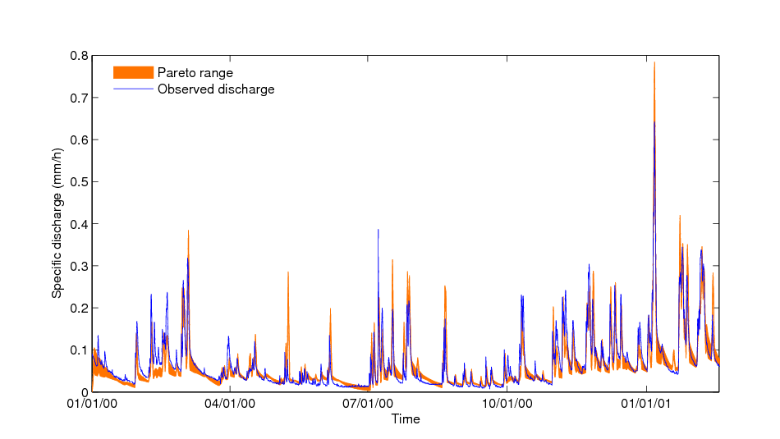
Parameter uncertainty
Multi-objective calibration: Example
✓ Objectives
✓ Sources of uncertainty
✓ Why do we care?
✓ Calibration
✓ Objective functions
✓ Optimization
Parameter uncertainty
New approaches
What have we learned?
Hydrograph
N_{HF} and N_{LF}
N_{HF,} N_{LF} and N_{WT}

Slide 49
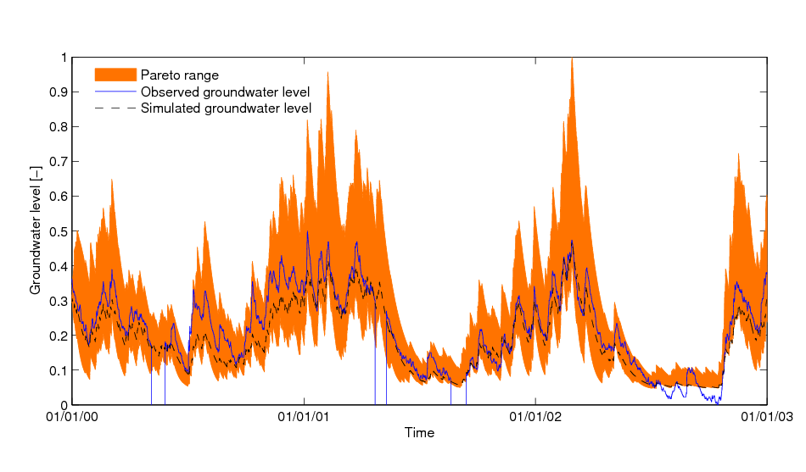
Parameter uncertainty
Multi-objective calibration: Example
✓ Objectives
✓ Sources of uncertainty
✓ Why do we care?
✓ Calibration
✓ Objective functions
✓ Optimization
Parameter uncertainty
New approaches
What have we learned?
Groundwater table

Slide 50
Parameter uncertainty
✓ Objectives
✓ Sources of uncertainty
✓ Why do we care?
✓ Calibration
✓ Objective functions
✓ Optimization
Parameter uncertainty
New approaches
What have we learned?
Multi-objective calibration
Takes into account the multi-objective nature of the calibration problem
Takes into account that different parts of the hydrograph can be subject to different error processes
Reflects the model’s inability to correctly and simultaneously simulate different aspects of the simulations

Slide 51
Stepped Calibration Approach
✓ Objectives
✓ Sources of uncertainty
✓ Why do we care?
✓ Calibration
✓ Objective functions
✓ Optimization
✓ Parameter uncertainty
New approaches
What have we learned?
(1) Select different specific characteristics of the time series that should be well simulated, e.g. high and low flow.
(2) Associate model parameters with the selected characteristics
(3) Define objective functions that represent performance measures for modelling the selected characteristics
(4) Calibrate each group of parameters associated with each objective function individually, while fixing the remaining parameters at constant values

Slide 52
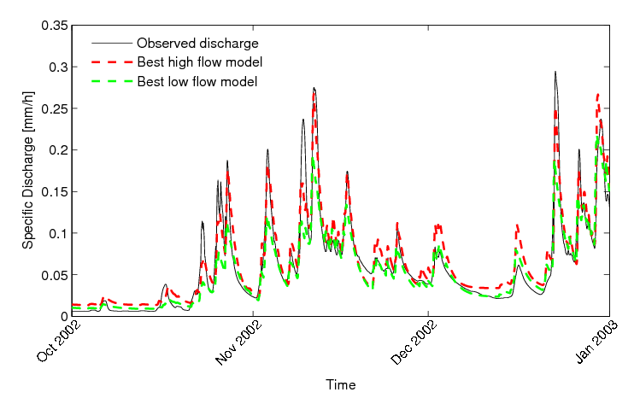
Stepped Calibration Approach
Example:
Calibration of stream flow with respect to high and low flows, i.e. NS and logNS
The optimal models related to two objective functions are different and both unrealistic
✓ Objectives
✓ Sources of uncertainty
✓ Why do we care?
✓ Calibration
✓ Objective functions
✓ Optimization
✓ Parameter uncertainty
New approaches
What have we learned?

Slide 53
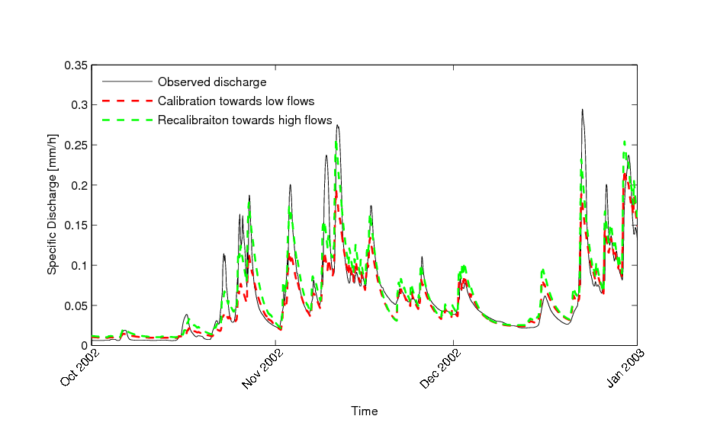
Stepped Calibration Approach
Example:
First calibrate the groundwater related parameters, i.e. low flow, and then the others. The baseflow simulation remains almost unchanged
✓ Objectives
✓ Sources of uncertainty
✓ Why do we care?
✓ Calibration
✓ Objective functions
✓ Optimization
✓ Parameter uncertainty
New approaches
What have we learned?

Slide 54
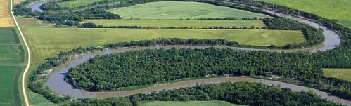
Stepped Calibration Approach
✓ Objectives
✓ Sources of uncertainty
✓ Why do we care?
✓ Calibration
✓ Objective functions
✓ Optimization
✓ Parameter uncertainty
New approaches
What have we learned?
Recognizes that results obtained by single objective calibration can be unrealistic
Tries to emulate the steps followed by hydrologists in manual calibration
Provides a balanced, physically realistic solution

Slide 55
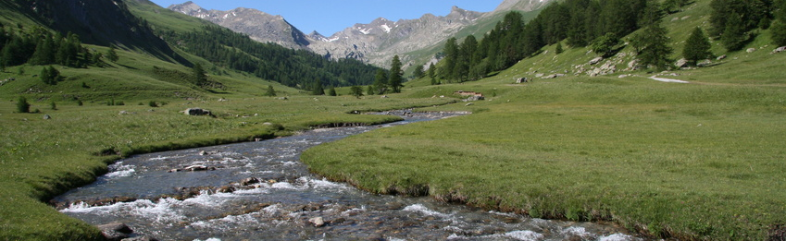
Dynamic Identifiability Analysis
✓ Objectives
✓ Sources of uncertainty
✓ Why do we care?
✓ Calibration
✓ Objective functions
✓ Optimization
✓ Parameter uncertainty
New approaches
What have we learned?
Analyses parameter identifiability in a moving
time window:
(1) allows analysing how different regimes influence identifiability of model parameters
(2) allows investigating the assumption that model parameters are constant in time

Slide 56
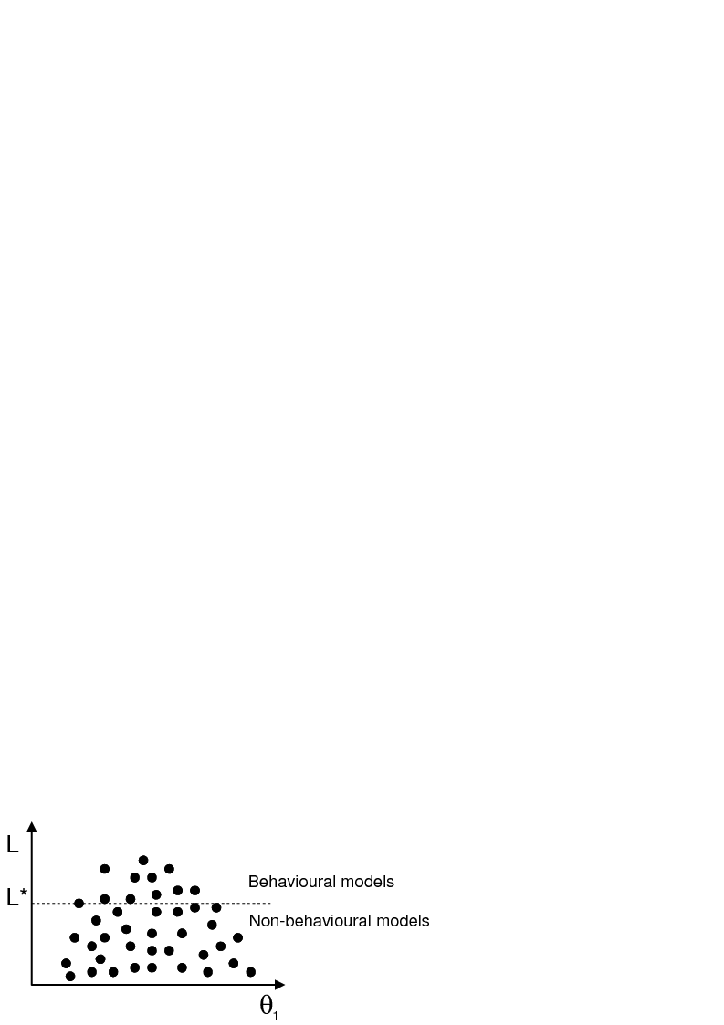
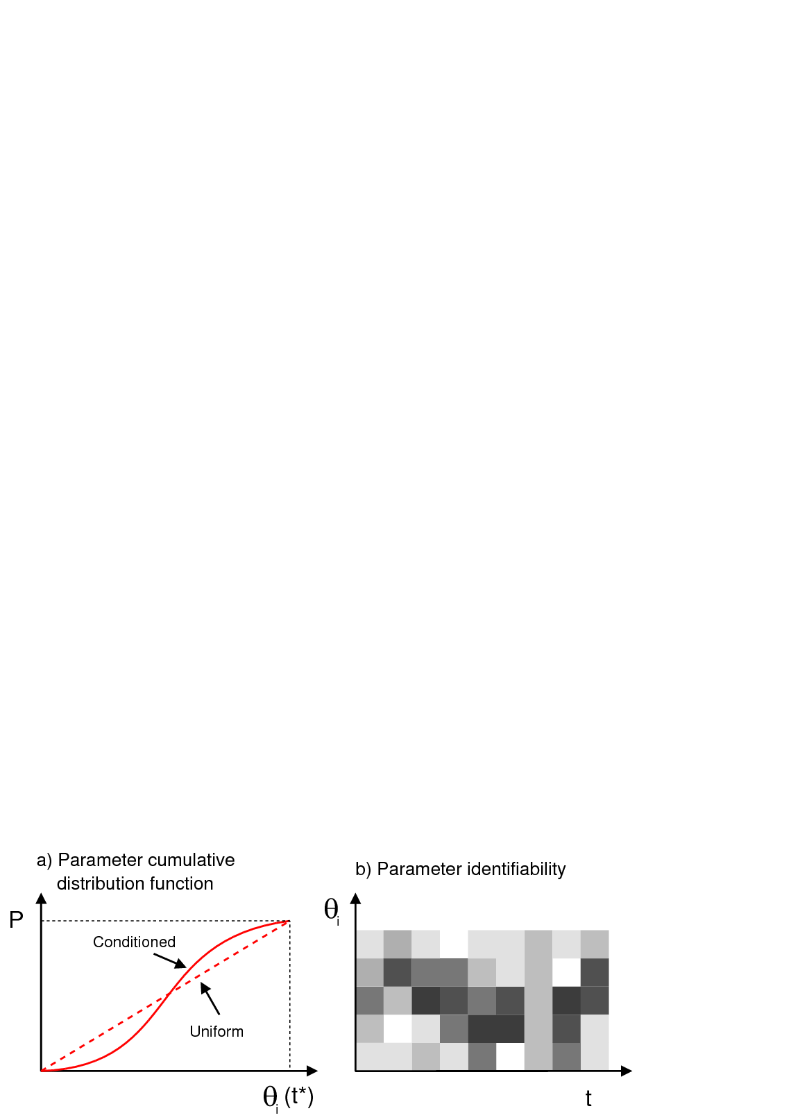
Dynamic Identifiability Analysis
Sample feasible parameter space
(2) Construct cumulative parameter distribution functions
(3) Evaluate parameter identifiability for each time step
✓ Objectives
✓ Sources of uncertainty
✓ Why do we care?
✓ Calibration
✓ Objective functions
✓ Optimization
✓ Parameter uncertainty
New approaches
What have we learned?

Slide 57
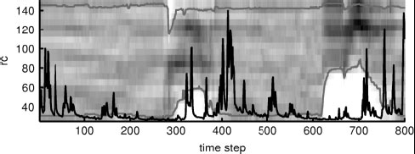
Dynamic Identifiability Analysis
✓ Objectives
✓ Sources of uncertainty
✓ Why do we care?
✓ Calibration
✓ Objective functions
✓ Optimization
✓ Parameter uncertainty
New approaches
What have we learned?

Slide 58
Dynamic Identifiability Analysis
✓ Objectives
✓ Sources of uncertainty
✓ Why do we care?
✓ Calibration
✓ Objective functions
✓ Optimization
✓ Parameter uncertainty
New approaches
What have we learned?
Parameter N_{lagf}, which represents the lag time of the system, is non-stationary, i.e. it decreases with time

Slide 59
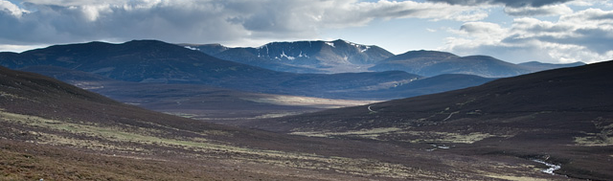
Dynamic Identifiability Analysis
✓ Objectives
✓ Sources of uncertainty
✓ Why do we care?
✓ Calibration
✓ Objective functions
✓ Optimization
✓ Parameter uncertainty
New approaches
What have we learned?
It allows analyses of parameter identifiability in time
It is useful to enhance model structural limitations
It can help to detect regimes with higher information content than others for specific parameters

Slide 60
Current view on model evaluation
✓ Objectives
✓ Sources of uncertainty
✓ Why do we care?
✓ Calibration
✓ Objective functions
✓ Optimization
✓ Parameter uncertainty
✓ New approaches
What have we learned?
Requirements for model application:
Model parameters have to be well identifiable
The model has to be able to adequately reproduce the observations
The model has to be a realistic representation of the natural system
Requirements for model evaluation:
Evaluate the model with respect to the above mentioned aspects
Identify the effect of various sources of error on model predictions and parameters

Slide 61
Current state
✓ Objectives
✓ Sources of uncertainty
✓ Why do we care?
✓ Calibration
✓ Objective functions
✓ Optimization
✓ Parameter uncertainty
✓ New approaches
What have we learned?
At present no unique framework for the evaluation of all aspects related to model evaluation
Different approaches could be combined based on the requirements of the specific problem

Slide 62
